Slide 1
Dooley Pharmaceuticals Inc
Identifying top performing employees who are at risk of leaving.

Slide 2
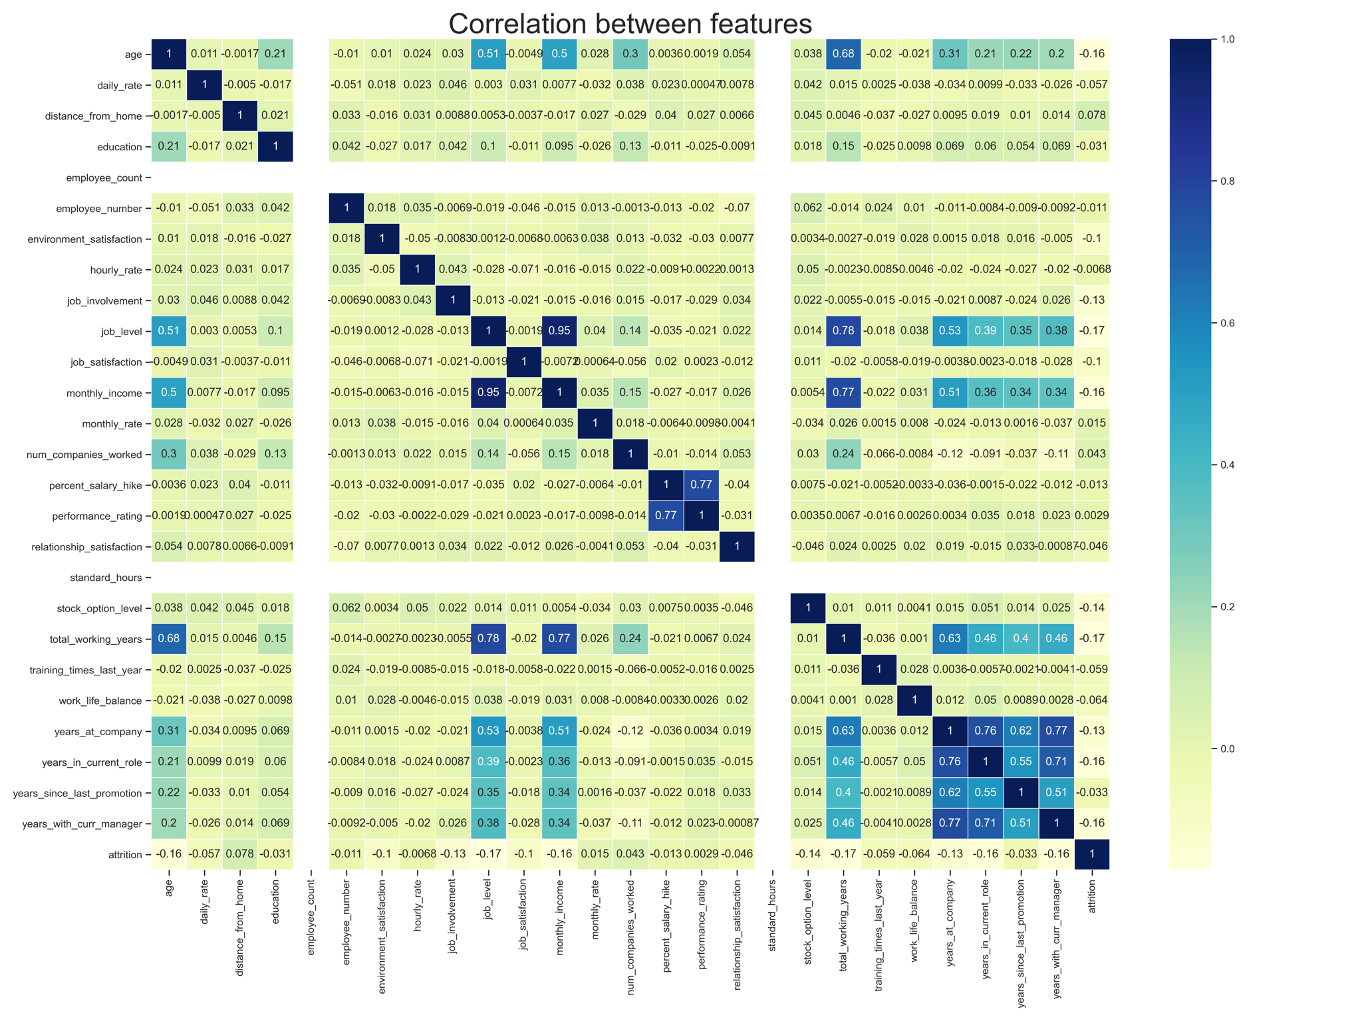
Important Features of the dataset
age
job_level
monthly_income
total_working_years
years_at_company
years_in_current_role
percent_salary_hike
performance_rating

Slide 3
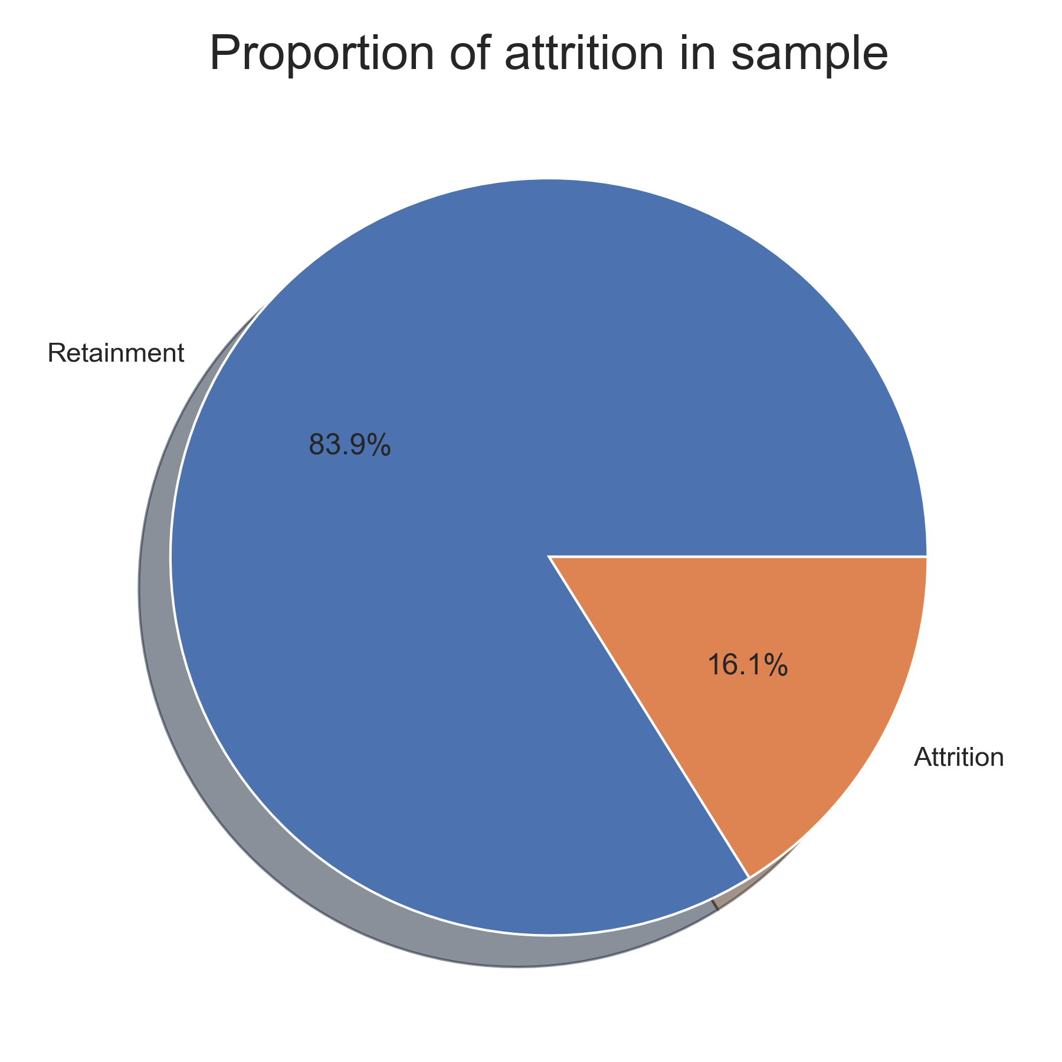
Proportion of Attrition in Sample
Looking at this it is clear that we have an unbalanced dataset.

Slide 4
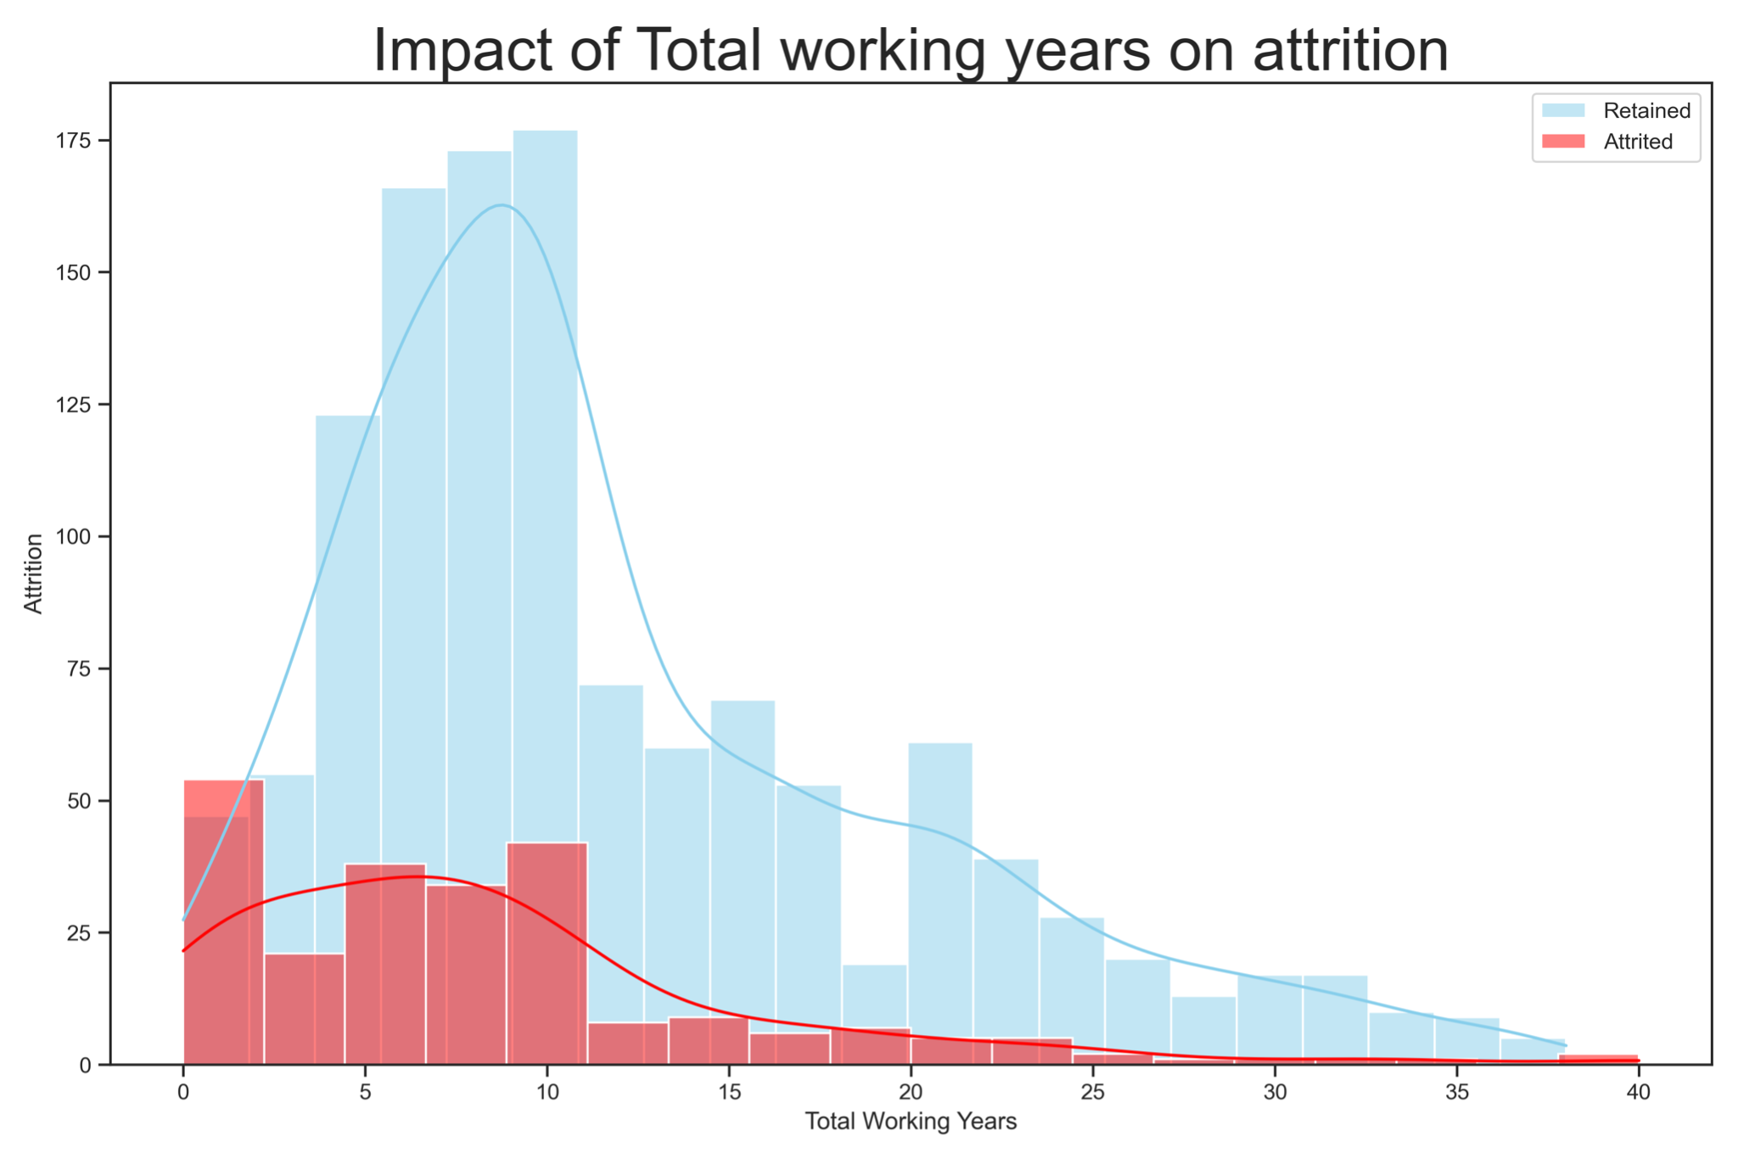
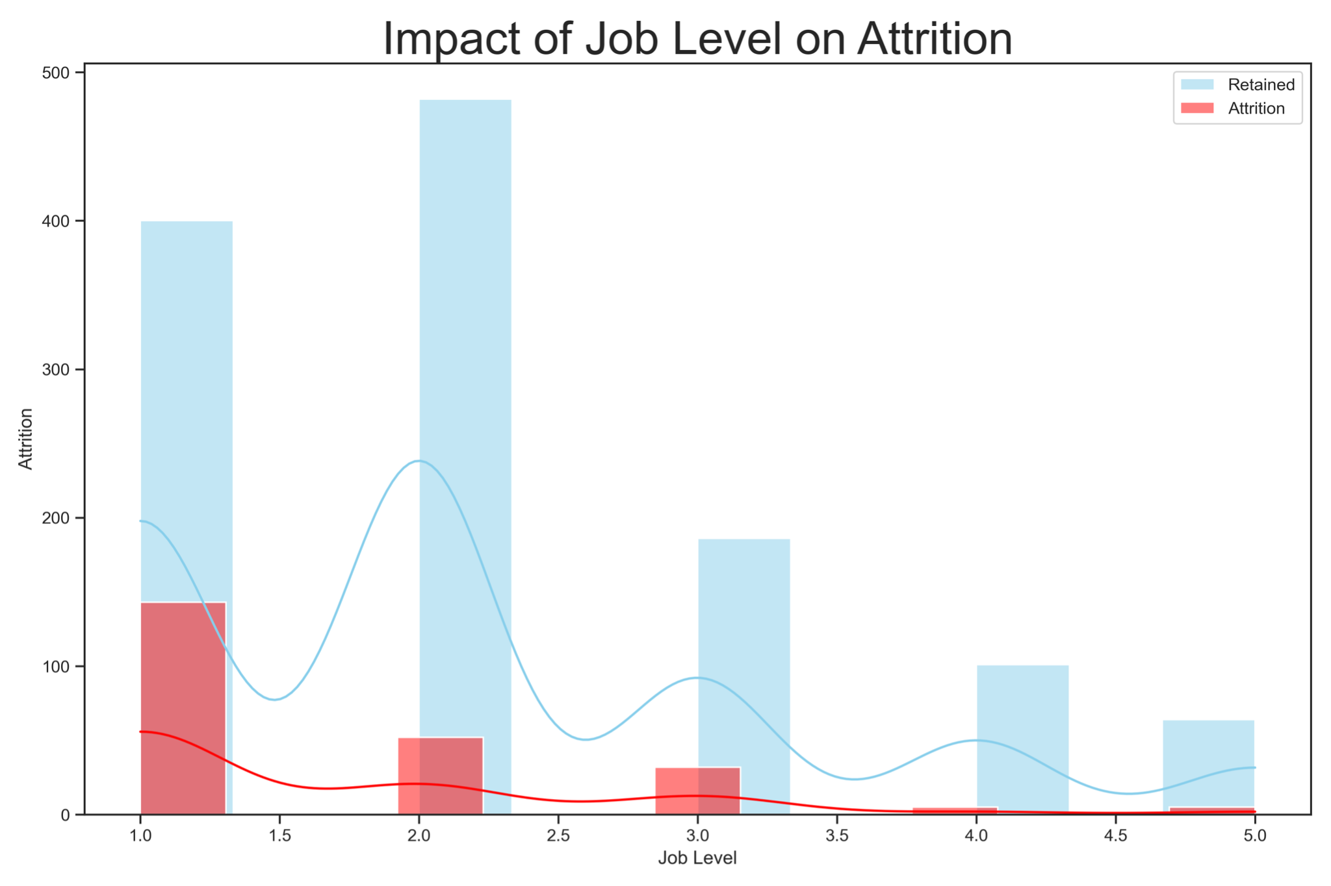
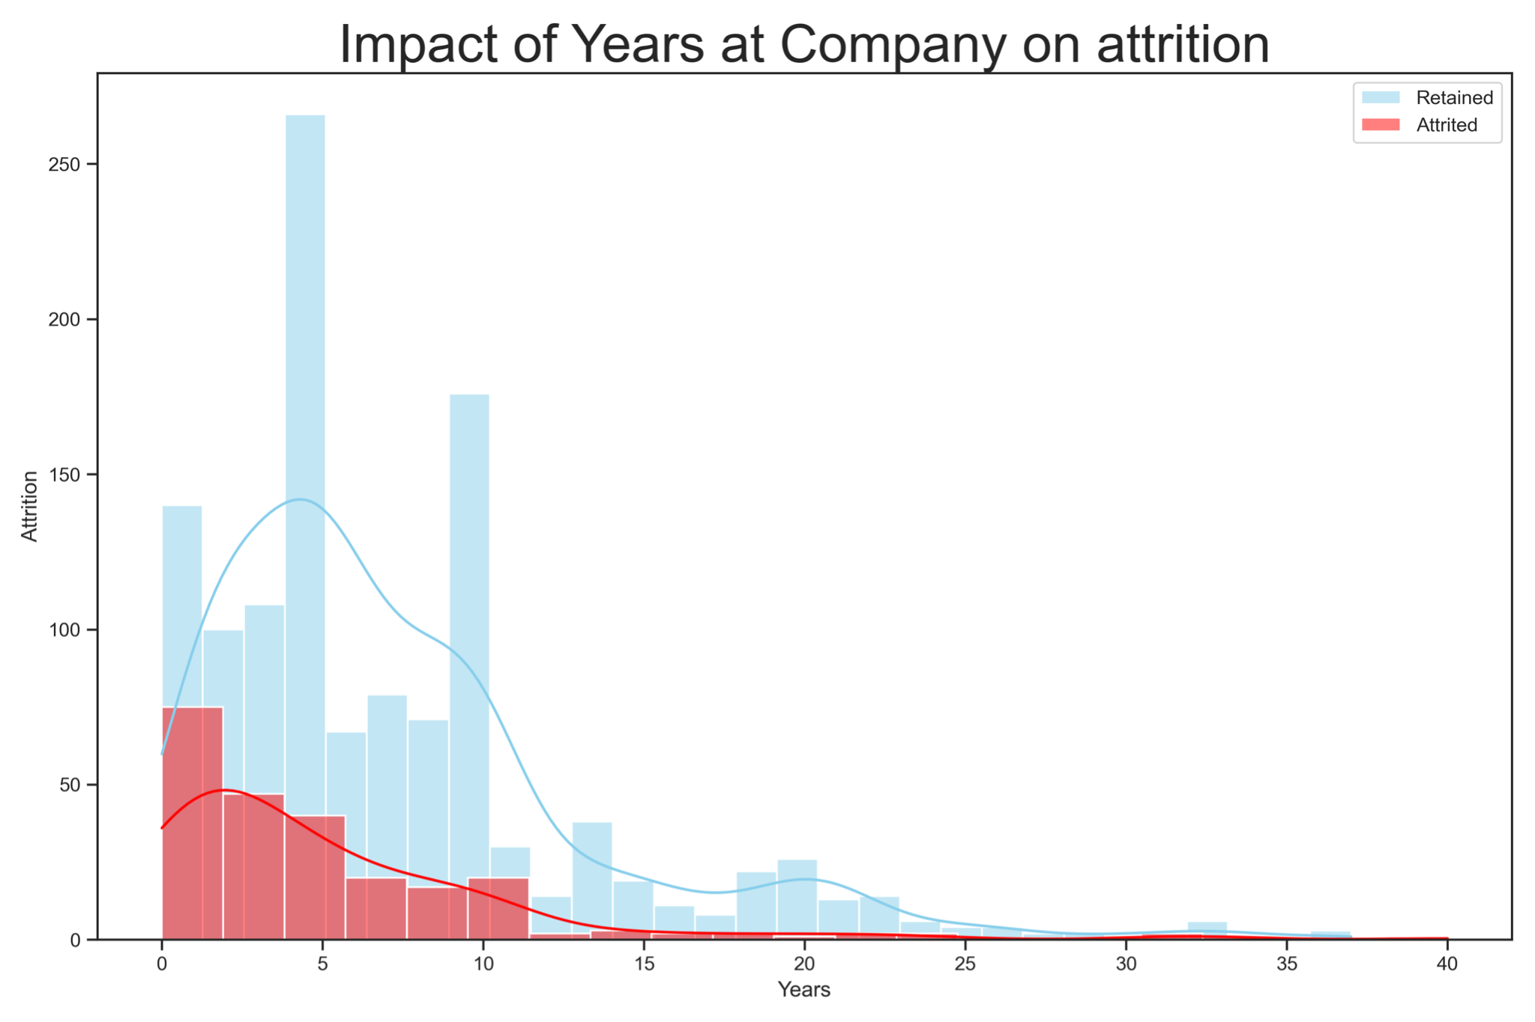
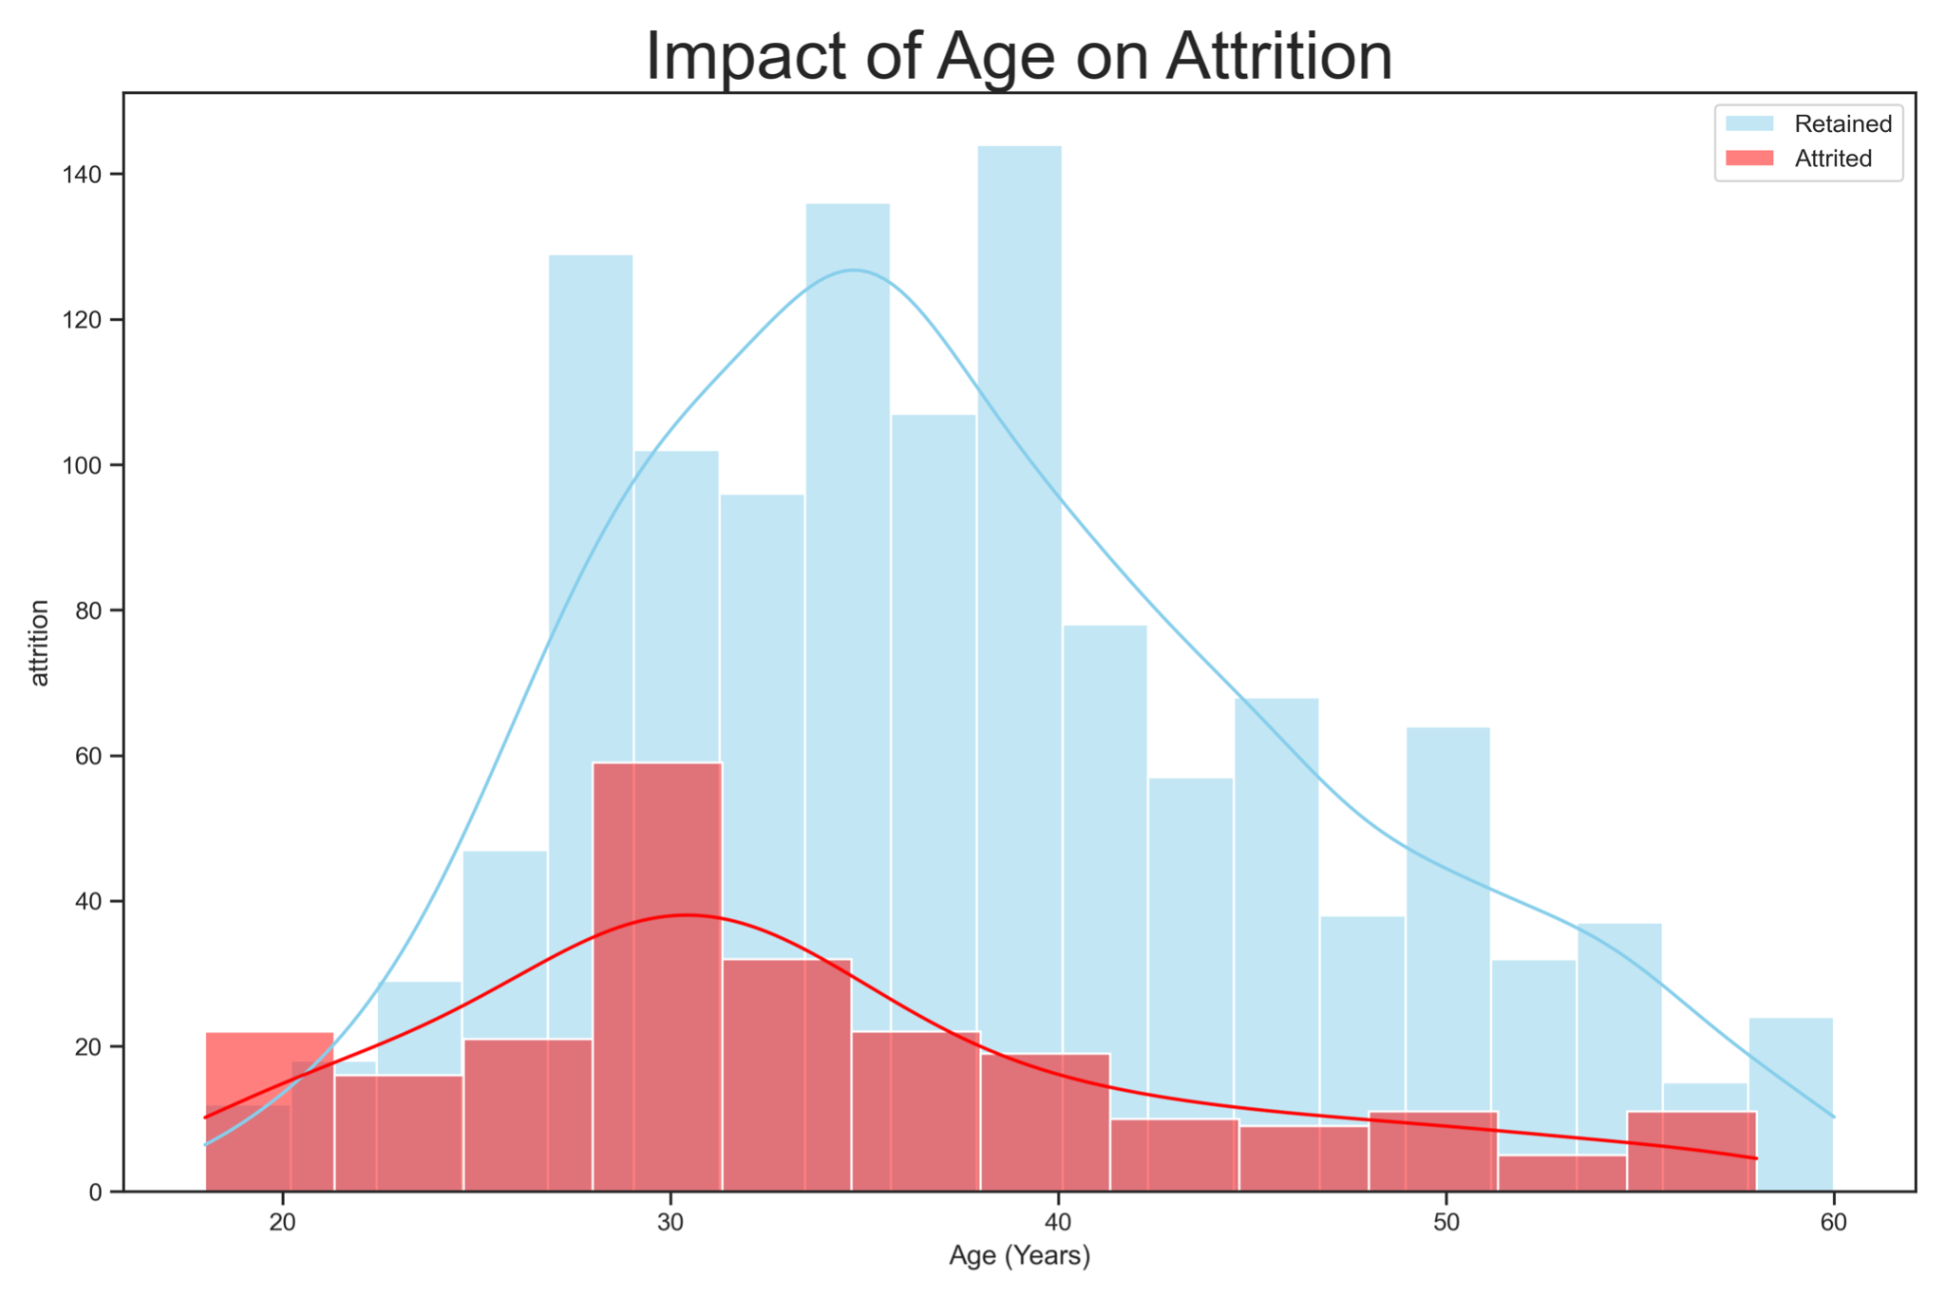
Impact of various important feature on Attrition

Slide 5
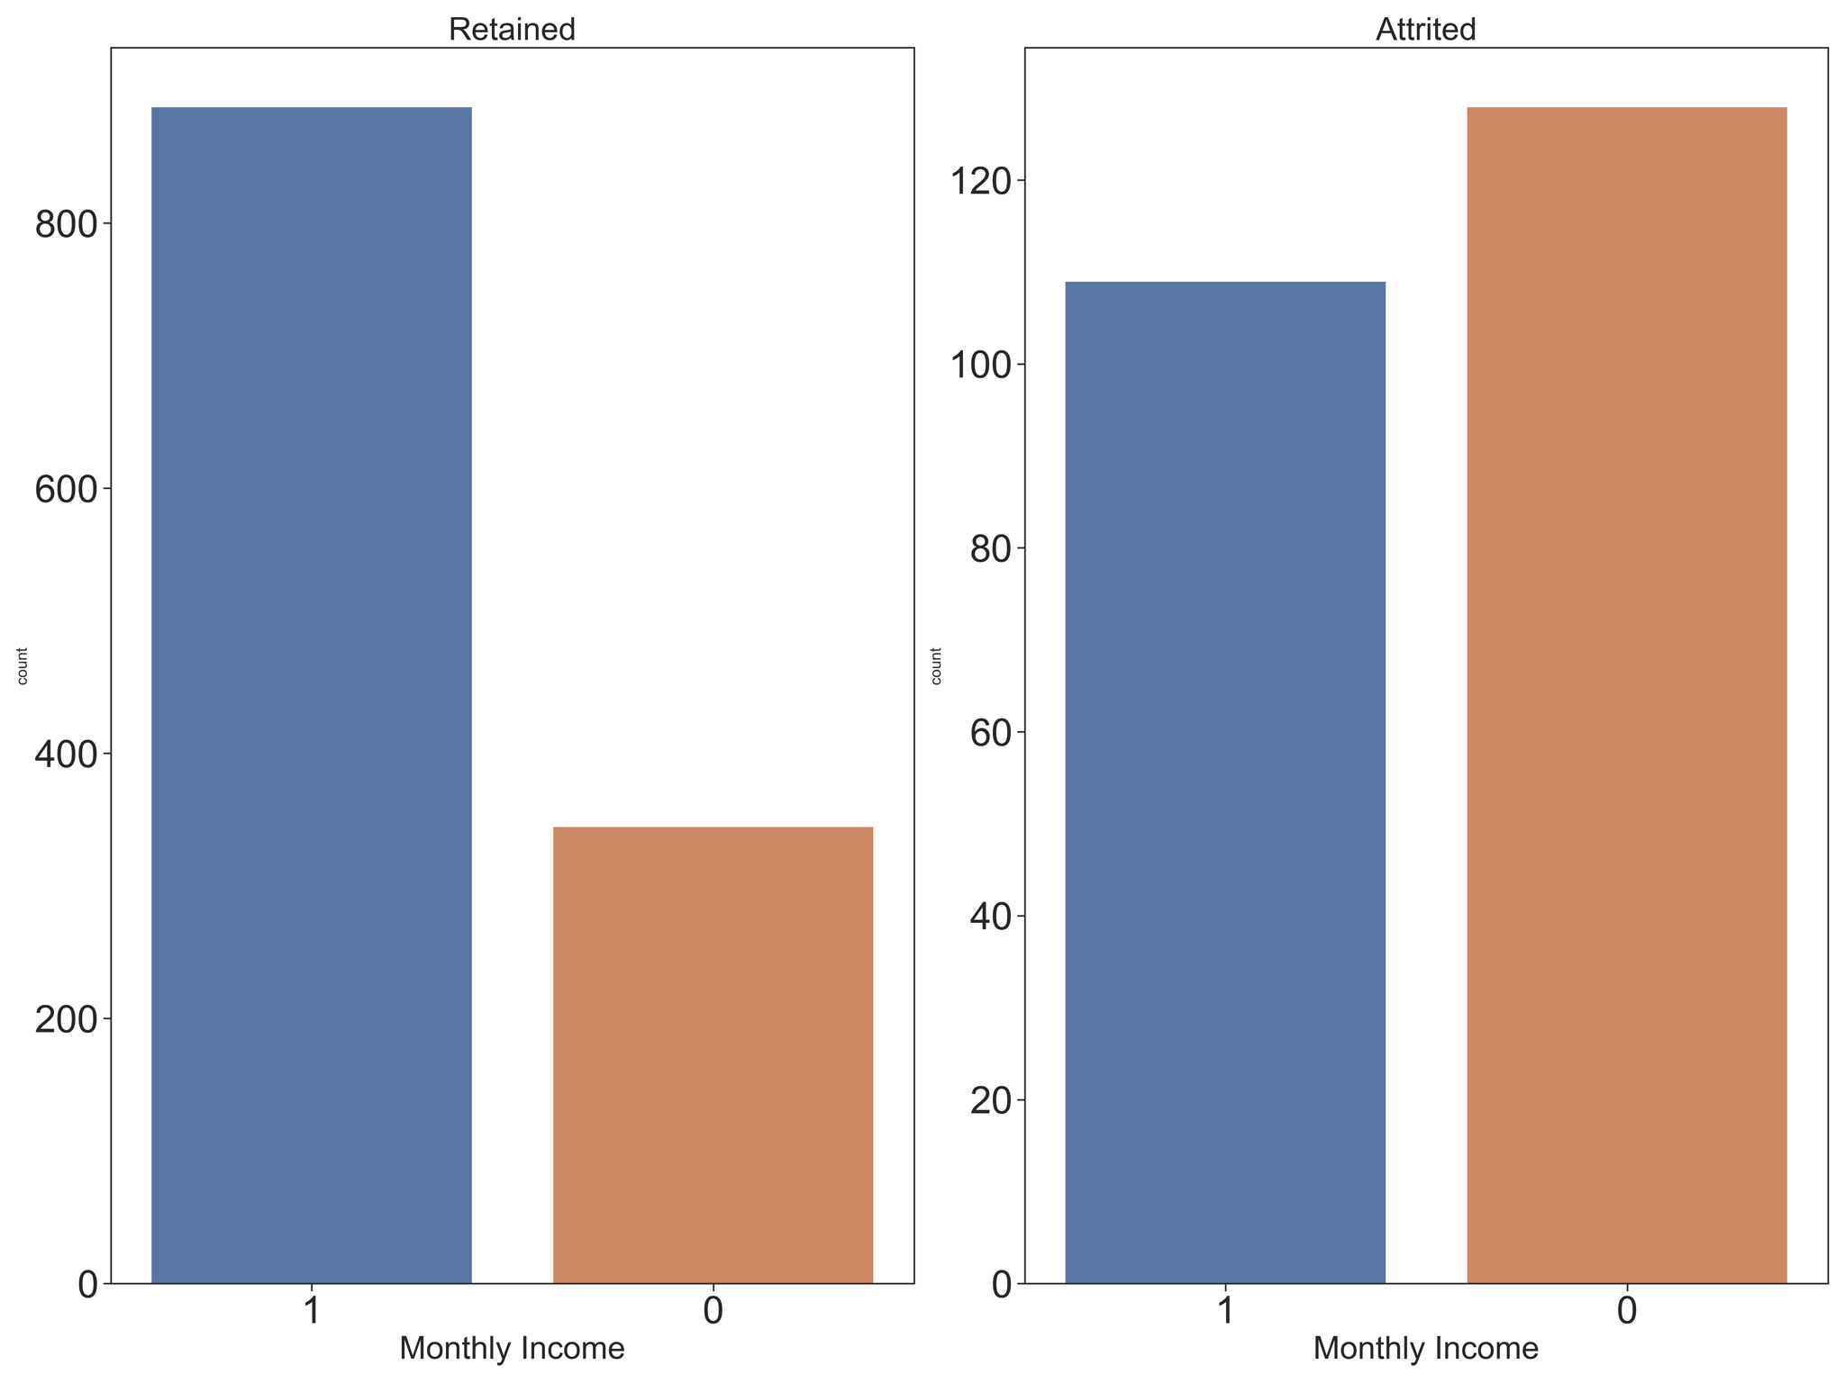
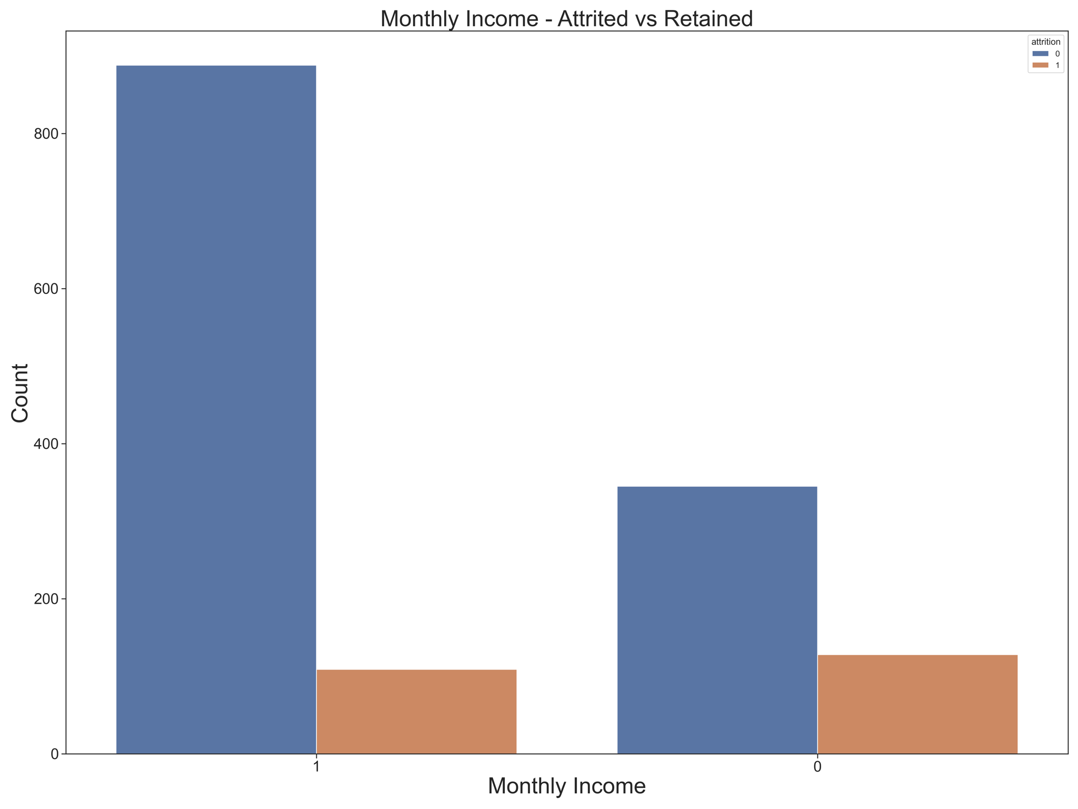
Two Categories as two separate plots.
Two Categories as single plot.

Slide 6
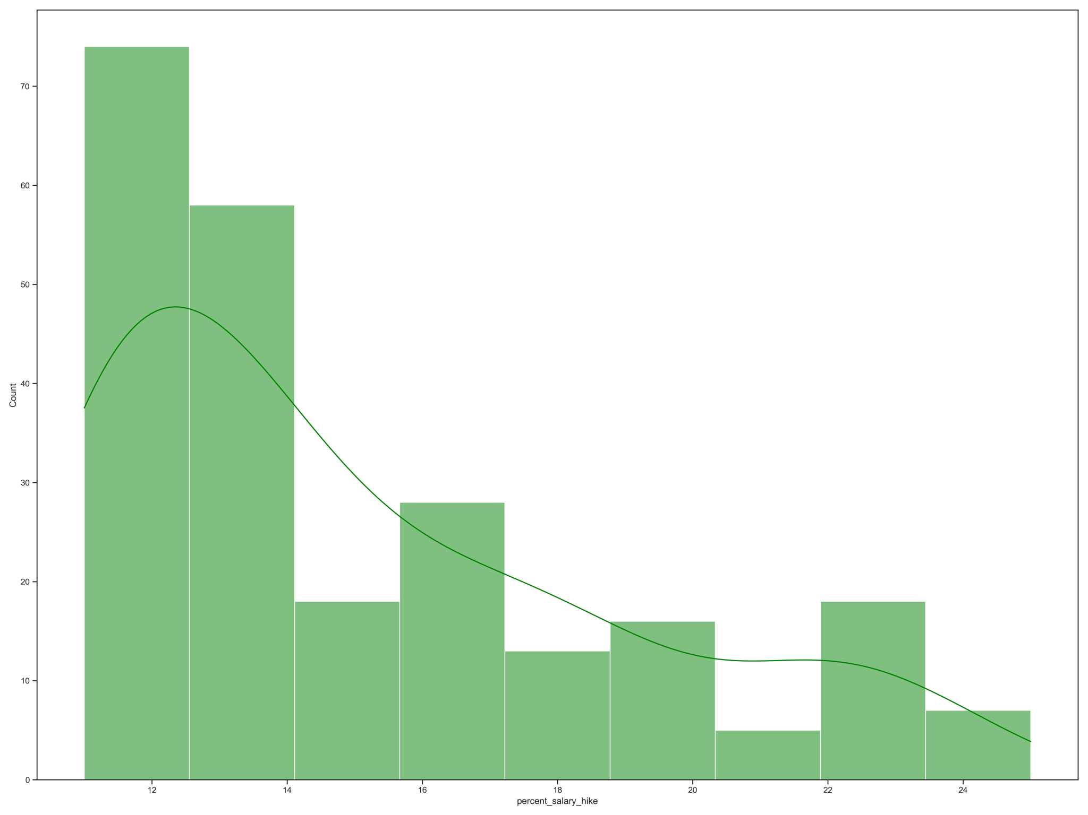
Univariate Data Visualisation - Percentage of Salary Hike
Count
Percentage of Salary Hike

Slide 7
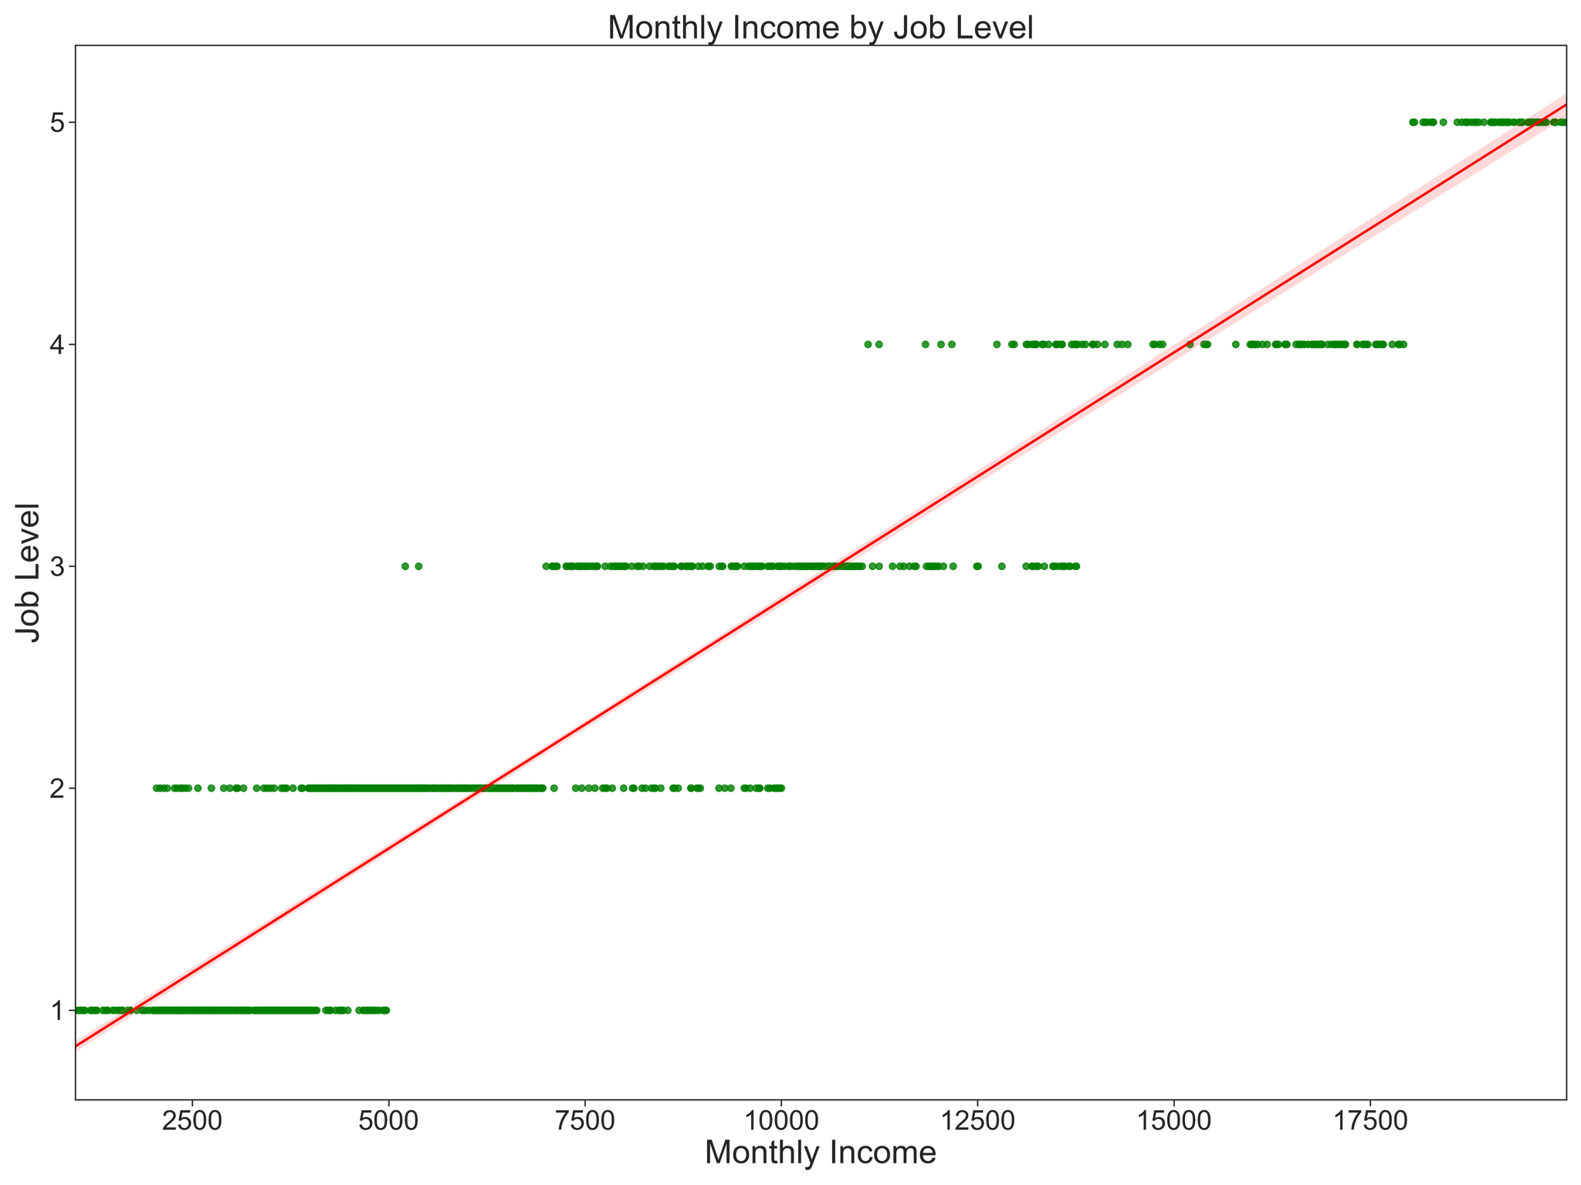
Bivariate Data Visualisation - Monthly Income

Slide 8
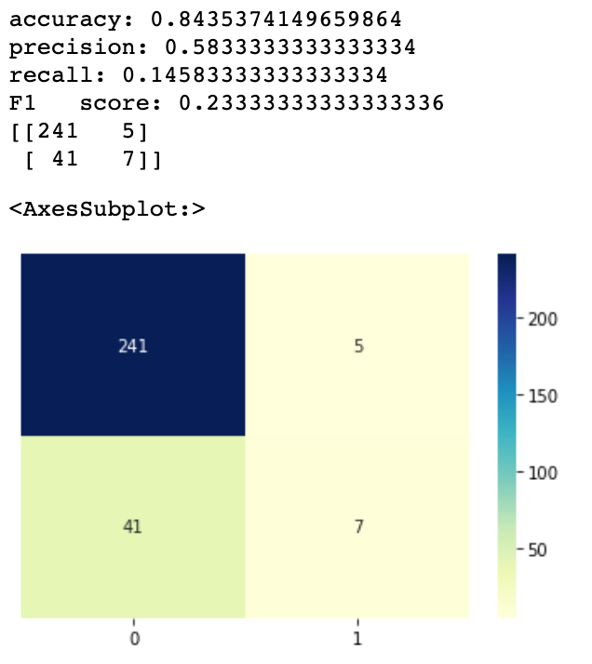
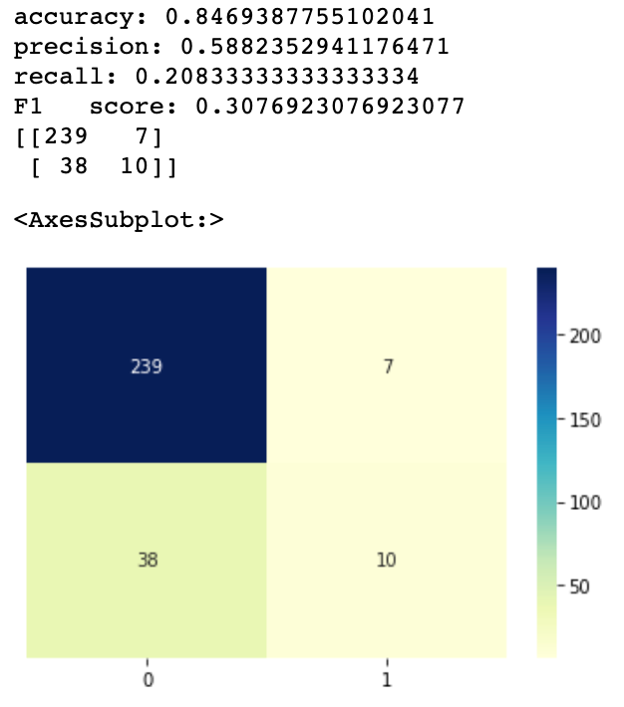
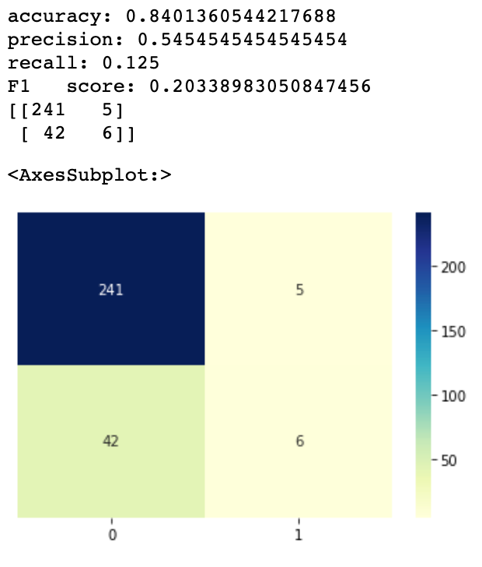
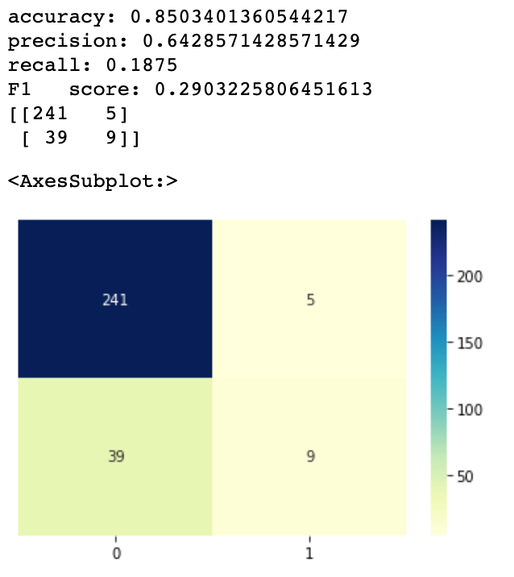
Identifying Best Model
Random Forest
KNN
All Features
Best Features
All Features
Best Features

Slide 9
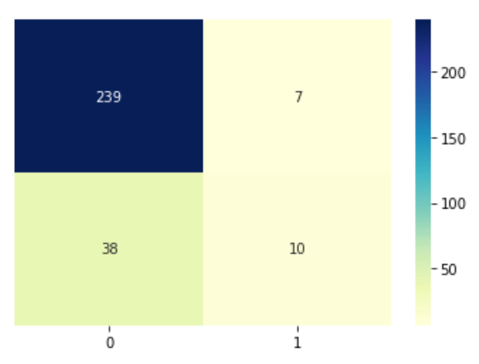
Confusion matrix
The Confusion Matrix shows that we have
239 True Positives,
7 False Positives,
38 False Negatives
and 10 True Negatives.

Slide 10
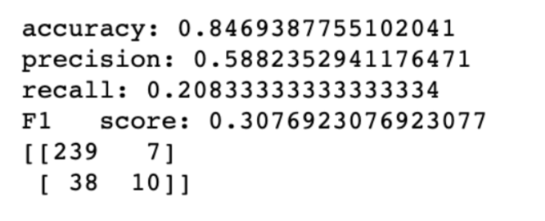
Limitations
The dataset is unbalanced.
The recall of the model is very low.
The model is ‘idealization’ of the reality since number of assumptions were made.

Slide 11
Type I & Type II Errors
According to confusion matrix, we have 7 Type I errors and 38 Type II errors in the model.

Slide 12
Using and Deploying the Model
The model can be used as a Recommender System. Predictions about who is most likely to leave the company, will be available upon request.
The deployment of the model will depend on:
How frequently the predictions would be generated,
Whether these predictions will be generated for an individual or a group,
The number of applications that will access the model and
The latency of the product.
Considering all these factors the model may store the chances of the employees attrition in a database beforehand and change if the selected features change or calculate the probability as requested.

Slide 13
5 strong recommendations
It is seen that highest level of attrition is seen amongst the employees who are in the first 10 years of their total working years. These employees should be provided with a feeling of job security and motive to stay so that the attrition rate remains low.
The second factor, that shows a clear reason of attrition is Job Level. Most of the employees who left the company were in Job Level 1, 2 or 3 after which the attrition rate is negligible. This clearly indicates that employees in these Job Levels should be focused on.
The third factor, Years at Company shows us that a large part of the employees who left the company were a part of the company for 12 years or less, after which attrition rates dropped significantly so these employees can be promised a big incentive if they complete 10 or 12 years in the company which would keep them motivated to stay in the company through that period.
Attrition rates seem to be high in the period where the age of the employee is between 28-32 years. Usually this is the time, that employees start looking for growth opportunities since they accumulate enough experience up till this age. This problem can be solved by offering them growth opportunities in the company itself, so that they do not have to move to other companies for that.
Finally, it was seen that most of the employees that left the company were with their managers for 0-3 years, after which the attrition levels dropped. This shows that employees face difficulty working with new managers and they feel this upto three years. To solve this problem the company can try to not change team managers frequently and if it is really necessary, try different strategies to make them comfortable working with each other.

